Slide 1


Sponsored Programs Administration Resource & Knowledge Series
GETTING STARTED
Presented by:
Svetlana Shtrom PhD., John Miner, Terri Vallery,
Betsy Gray, Hilary Hitchner, Douglas Backman

Slide 2


General Business
Cell Phones On Silent
Sign In
GETTING STARTED

Slide 3
General Business
Interested in Certification?
Want to Be a Certified Research Administrator?
http://www.cra-cert.org/
Email Doshie Walker to let her know that you are interested in the participating in the CRA Study Group!
GETTING STARTED

Slide 4
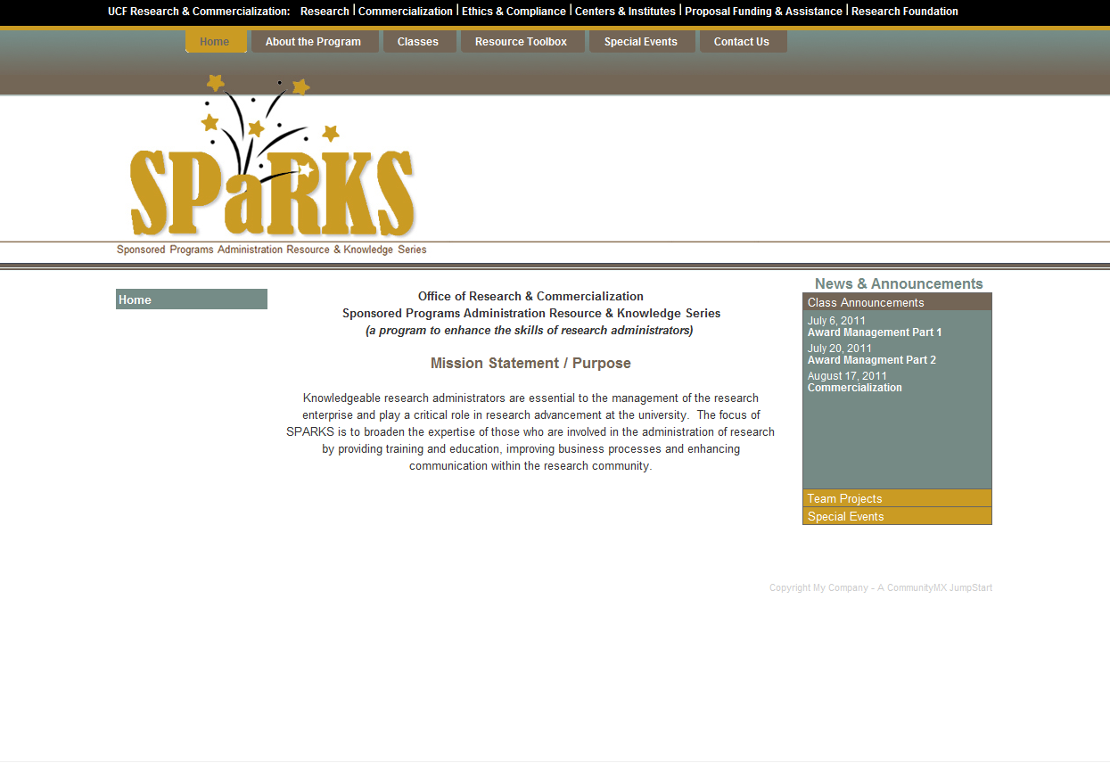
General Business
SPaRKS website is available!
www.sparks.research.ucf.edu
GETTINIG STARTED

Slide 5
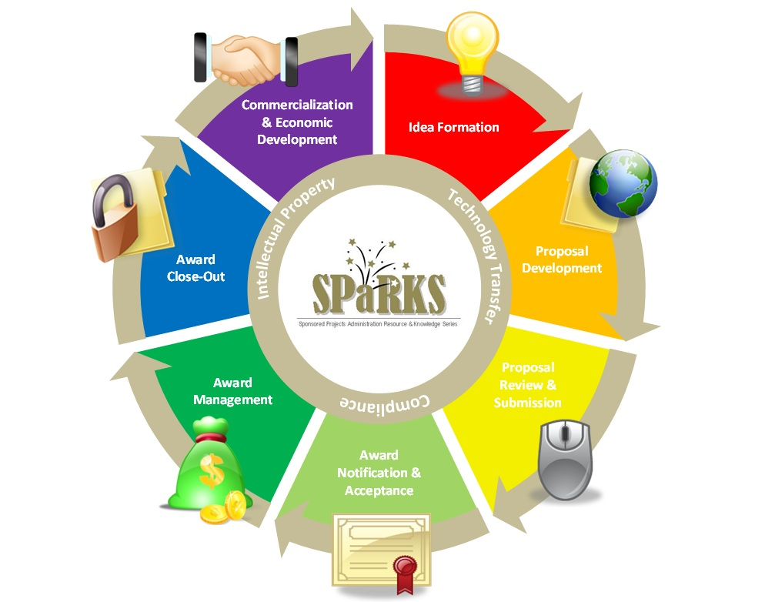
Exploring Research Administration…from CONCEPT to COMMERCIALIZATION

Slide 6
Exploring Research Administration…from CONCEPT to COMMERCIALIZATION
DEVELOPING IDEAS
Svetlana Shtrom, PhD.
John Miner

Slide 7
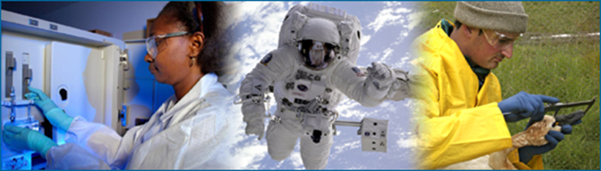
SOURCES OF IDEAS
Research results
  Gradual advancement of on-going research
  Screens for new pathways or biomarkers
  Unexpected findings
Scientific publications / conferences
  Significant new findings in the field
  Discoveries from other fields applied to current field
Collaboration
  Intramural
  Extramural
Serendipity
  Any time; anywhere
Source: http://undsci.berkeley.edu/index.php
GETTING STARTED

Slide 8
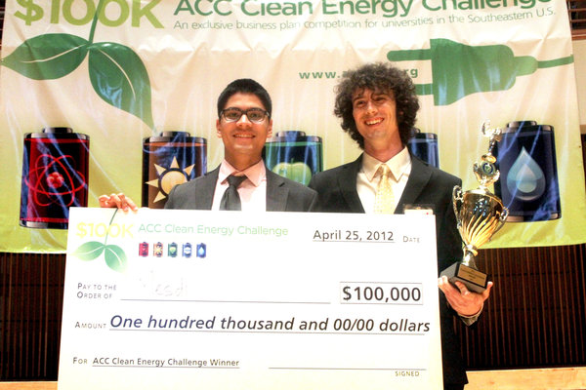
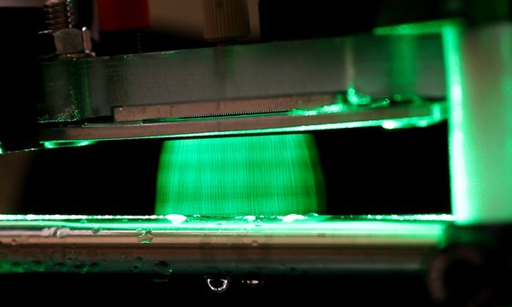
SOURCES OF IDEAS: RESEARCH
Research results
  Gradual advancement of on-going research
  Screens for new pathways or biomarkers
  Unexpected findings
Source: http://www.orlandosentinel.com/technology/blog/os-ucf-wins-clean-energy-challenge-20120503,0,3956293.post
Electrospray technology to improve the manufacturing process for making lithium ion batteries,
photovoltaic solar cells, medical devices, pharmaceuticals and other products
GETTING STARTED

Slide 9
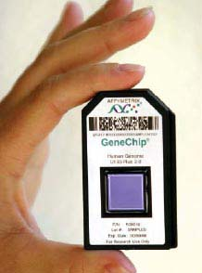
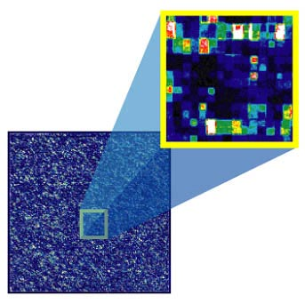
SOURCES OF IDEAS: RESEARCH
Research results
  Gradual advancement of on-going research
  Screens for new pathways or biomarkers
  Unexpected findings
Source: Affymetrix
GETTING STARTED

Slide 10
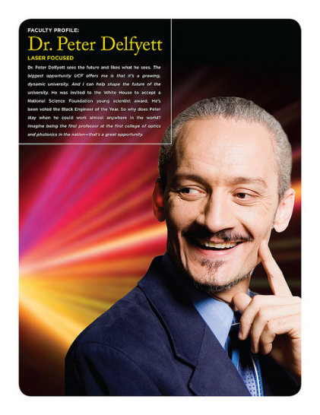
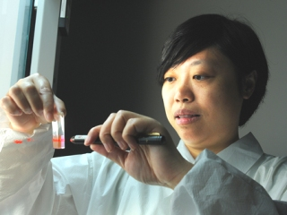
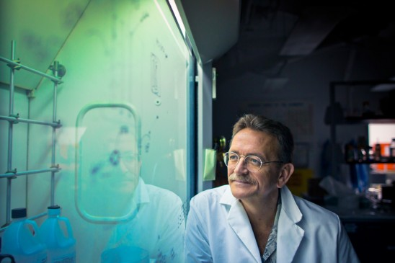
SOURCES OF IDEAS: PUBLICATIONS
Scientific publications / conferences
  Significant new findings in the field
  Discoveries from other fields applied to current field
Interference patterns akin to those of spectral interferometry can be obtained in the microwave regime by adding the photocurrents. In this fashion, an extremely high-resolution version of white light spectral interferometry can be performed. IEEE Journal of Lightwave Technology
“Our nanoparticles not only seek out a chemical reaction that is specific to prostate cancer, they can also tell us how aggressive the cancerous cells are likely to be, which can give doctors better information to treat their patients.” Journal of Translational Medicine
For the first time ever, stem cells from umbilical cords have been converted into other types of cells, which may eventually lead to new treatment options for spinal cord injuries and multiple sclerosis, among other nervous system diseases. ACS Chemical Neuroscience
GETTING STARTED

Slide 11
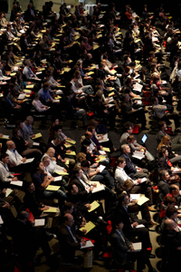

SOURCES OF IDEAS: CONFERENCES
Scientific publications / conferences
  Significant new findings in the field
  Discoveries from other fields applied to current field
Source: American Association for Cancer Research
GETTING STARTED

Slide 12




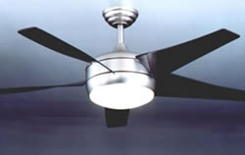



SOURCES OF IDEAS: COLLABORATION
Collaboration
  Intramural
  Extramural
GETTING STARTED
Notes:
Zinc oxide nanowire waveguide lasers, which can offer smaller sizes,
lower costs, higher powers and shorter wavelengths, could potentially
lead to a new way to kill viruses and increase the storage capacity of DVDs

Slide 13

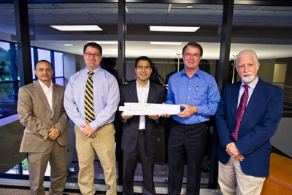
SOURCES OF IDEAS: SERENDIPITY
Serendipity
  Dr. Danny Parker (FSEC) enjoying a quiet afternoon
  on his porch…
Sources: http://www.research.ucf.edu/news/20110706CeilingFanSetsRecord.html;
http://www.gossamerwind.com/content/what-so-special-about-these-fans-0
1.7 Million Sold - UCF Ceiling Fan Sets Record
GETTING STARTED

Slide 14
SOURCES OF IDEAS
Research results
  Gradual advancement of on-going research
  Screens for new pathways or biomarkers
  Unexpected findings
Scientific publications / conferences
  Significant new findings in the field
  Discoveries from other fields applied to current field
Collaboration
  Intramural
  Extramural
Serendipity
  Any time; anywhere
Source: http://undsci.berkeley.edu/index.php
GETTING STARTED

Slide 15
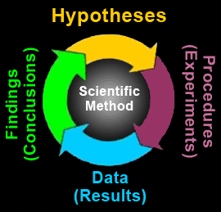






IDEAS and INTELLECTUAL PROPERTY
Apply for funding
Obtain Materials
Share
ideas
GETTING STARTED

Slide 16
CONTACT INFORMATION
Office of Technology Transfer
12201 Research Parkway, Suite 201
Orlando, FL 32826
Director: Assistant Director:
Svetlana Shtrom, 407-823-5150 Andrea Adkins, 407-823-0138
svetlana.shtrom@ucf.edu andrea.adkins@ucf.edu
Engineering, Nano, Chemistry
Assistant Director: Senior Licensing Associate:
John Miner, 407-882-1136 Brion Berman, 407-882-0342
john.miner@ucf.edu brion.berman@ucf.edu
CREOL, FSEC, Chem. (Forensics) BSBS, Nano, COM, Chemistry
Technology Manager: Technology Manager:
Sandra Jaggernauth, 407-882-2448 Amanda Reno, 407-882-0350
dhankumari.jaggernauth@ucf.edu amanda.reno@ucf.edu
Physical Sciences Life Sciences
GETTING STARTED

Slide 17

QUESTIONS or COMMENTS?

Slide 18
Exploring Research Administration…from CONCEPT to COMMERCIALIZATION
PARTNERING AGREEMENTS
Terri Vallery

Slide 19
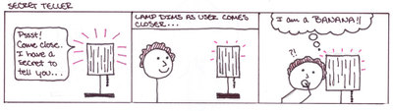
Non-disclosure agreement
PURPOSE
Protect information considered proprietary or confidential
Creates confidential relationship between two parties
a.k.a. Confidential Disclosure Agreement, NDA, CDA, PIA
GETTING STARTED

Slide 20
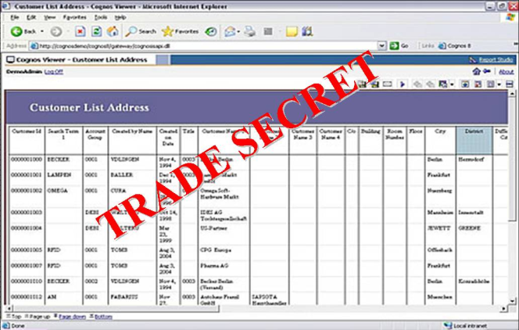
Non-disclosure agreement
WHEN TO USE IT
Two or more parties deciding whether to collaborate
Protected information must be shared
  Designs
  Ideas
  Financial information
  Trade secrets
  Confidential information in copyrighted software
GETTING STARTED

Slide 21
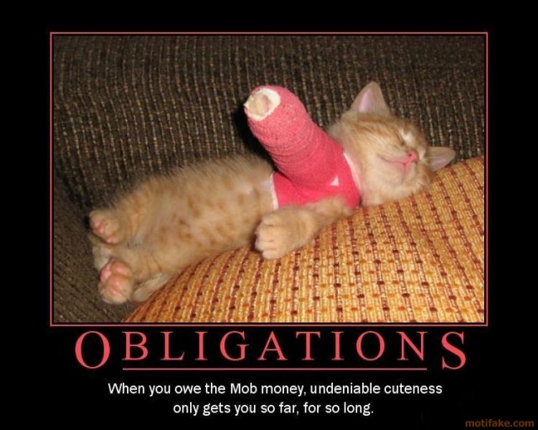
Non-disclosure agreement
WHAT IT INCLUDES
Definition of confidential information
Purpose of disclosure of information
Exclusions of confidential information
Obligations of receiving party
Time periods
Miscellaneous provisions
GETTING STARTED

Slide 22

Non-disclosure agreement
INTELLECTUAL
PROPERTY
PROVISIONS
GETTING STARTED

Slide 23


Teaming Agreement
PURPOSE
Temporary bridge between idea and final contract
Entities come together as a group to perform duties of a particular project
Defines each party’s responsibility in the bid process
PURPOSE
Temporary bridge between idea and final contract
Entities come together as a group to perform duties of a particular project
Defines each party’s responsibility in the bid process
GETTING STARTED

Slide 24

TEAMING AGREEMENT
WHEN TO USE IT
Prime contractor and a subcontractor agree to combine resources to bid on a project
Usually a major government project
GETTING STARTED

Slide 25

Teaming agreement
WHAT IT INCLUDES
Specifies party and project
Relationship of parties
Proposal preparation
Contract negotiation
Confidentiality
Protection of inventions
Miscellaneous provision
Appendix
GETTING STARTED

Slide 26

Teaming agreement
NOT
a contractual
commitment
of money
GETTING STARTED

Slide 27
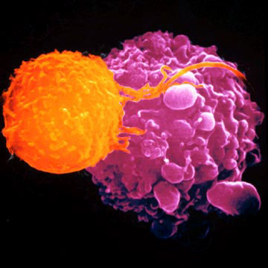
Material transfer agreement
PURPOSE
Governs the transfer of tangible research materials when the recipient intends to use it for his/her
own research purposes
Defines the rights of the provider and
recipient with respect to the material
and derivatives
GETTING STARTED

Slide 28
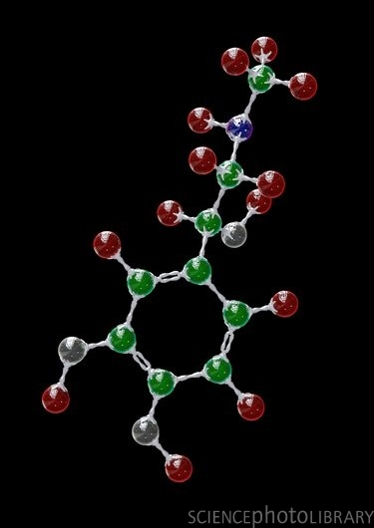
Material transfer agreement
WHEN TO USE IT
Transfer of biological materials
  Reagents, cell lines, plasmids
Biological Agreement
Transfer of other materials
  Chemical compounds
  Some types of software
Non-Biological Agreement
GETTING STARTED

Slide 29
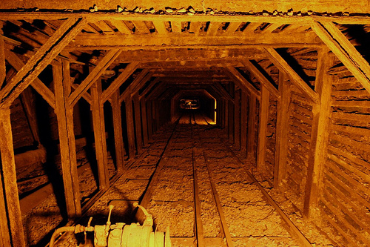
Material transfer agreement
WHAT IT INCLUDES
Definitions
Intended use
Ownership rights
Termination
Miscellaneous provisions
GETTING STARTED

Slide 30

Material transfer agreement
THREE TYPES OF MATERIAL TRANSFER SITUATIONS
Transfer between UCF and another academic institution
UBMTA
Transfer from industry to UCF
Usually with many restrictions that must be negotiated
Transfer from UCF to industry UCF template is used and negotiated
GETTING STARTED

Slide 31
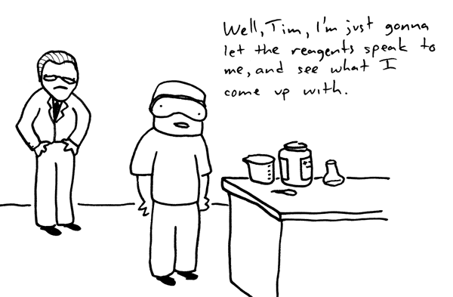
Material transfer agreement
TRANSFERS AND COMPLIANCE
IACUC – Live animals or custom antibodies
IRB – Human Tissue
Environmental Health & Safety – Hazardous materials and/or select agents
GETTING STARTED

Slide 32

Allocation of rights agreement
PURPOSE
Between a small business and partnering research institution to allocate:
Intellectual property rights
Rights to carry out follow-on research, development, or commercialization
GETTING STARTED

Slide 33



Allocation of rights agreement
WHEN TO USE IT
Required for all Small Business Technology Transfer (STTR) projects
Should be included with proposal
GETTING STARTED

Slide 34

Allocation of rights agreement
WHAT IT INCLUDES
Identifies background intellectual property the SBC can use non-exclusively for the research project
Royalty percentage of net sales when background intellectual property is used in the competitive commercialization of results
Project intellectual property rights
Guarantee that the Government shall maintain rights to background and project intellectual property
Miscellaneous provisions
GETTING STARTED

Slide 35
QUESTIONS or COMMENTS?

Slide 36
Exploring Research Administration…from CONCEPT to COMMERCIALIZATION
Strategies for Long Term Research Planning
Douglas Backman

Slide 37
Strategies for Long Term Research Planning
Research Compliance
Finance & Administration
Export Control
Facility Security
Conflict of Interest
Research Misconduct
Investigations and Audit Mitigation
GETTING STARTED

Slide 38
Strategies for Long Term Research Planning
Research Compliance
Finance & Administration:
Facilities & Administration Rate (overhead Rate)
Project collections & AR
Time & Effort Reporting
Cost Transfers
Major Project Exemptions
Contract & Grants Close-out
Federal Reports (ARRA, Small Business, Property)
Training and Briefings
GETTING STARTED

Slide 39
Strategies for Long Term Research Planning
Research Compliance
Export Control:
Identifying & Monitoring Controlled Technology
Technology Control Plans
Deemed Export Reviews
Licensing Foreign Nationals
Property Control
Training and Briefings
GETTING STARTED

Slide 40
Strategies for Long Term Research Planning
Research Compliance
Facility Security:
Secret Clearance Level
Classified Contracts DD254
Personnel Clearances
Travel Authorizations
On-line Technology Communications
Training and Briefings
GETTING STARTED

Slide 41
Strategies for Long Term Research Planning
Research Compliance
Conflict of Interest:
Potential Financial Conflict Of Interest Reporting System
A&P, USPS, OPS & Graduate Student COI Reporting System
Reporting Outside Activity and Potential Financial Conflicts
Federal Concerns – Bias Factor
State of Florida Transaction Conflicts
Florida State Exemption
Monitoring Plans
GETTING STARTED

Slide 42
Strategies for Long Term Research Planning
Research Compliance
Research Misconduct:
Research Misconduct (plagiarism, Falsification & Fabrication)
Responsible Conduct in Research – NSF
Training (CITI Modules & Graduate Studies Seminars)
PTF Certification
iThenticate Plagiarism & duplication software
Research Misconduct Policy & ORI Assurance
Assessment, Inquiry & Investigations
Reporting to NIH and NSF
GETTING STARTED

Slide 43
Strategies for Long Term Research Planning
Research Compliance
Investigations and Audit Mitigation:
Federal Audit - OMB Circular A-133
Agency Directed Audits (Federal , State, Industry)
Internal Audits
OIG Investigations (Research Misconduct, False Claims, Un-allowable Expenses & Other)
Desk Audits
Pre-award Audits
Program Audits
GETTING STARTED

Slide 44
Strategies for Long Term Research Planning
Research Compliance
Questions & Comments ???
Doug Backman
407-882-1168
dbackman@ucf.edu
GETTING STARTED

Slide 45
QUESTIONS or COMMENTS?

Slide 46
Exploring Research Administration…from CONCEPT to COMMERCIALIZATION
UCF RESEARCH FOUNDATION
Betsy Gray and Hilary Hitchner

Slide 47
WHAT is a RESEARCH FOUNDATION?
Research Foundation:
  a university affiliated nonprofit corporation providing services to a defined degree to its university’s research program
Defined Degree:
  the scope of services provided varies widely, ranging from providing comprehensive grants and contracts administration and related business services to a more narrowly focused mission, and many variations between the two
Research Program:
  sponsored research from federal, state, private foundations and industry; can also include internally funded programs
  RF’s are not all created equal!
GETTING STARTED

Slide 48
WHY HAVE A RESEARCH FOUNDATION?
  Sponsored research and its applicable functions and activities can sometimes be more effectively carried out under a separate but affiliated corporate structure
  Restrictive state environments can limit the ability of universities to effectively carry out research and research-related functions
GETTING STARTED

Slide 49
How DO RESEARCH FOUNDATIONs HELP?
Fiscal Year Issues
  No long dead periods between fiscal years (UCF April/May – Aug/Sept)
  Purchasing/Contracting
  Streamlined bid processes enable expedited receipt of equipment & supplies
  Ability to enter into multi-year contracts such as equipment or vehicle leases
  PI’s can make purchases on their own, and be reimbursed later; or they can work with the RF to place and pay for the order
GETTING STARTED

Slide 50
How DO RESEARCH FOUNDATIONs HELP?
Intellectual Property Management
  Own & license intellectual property
  Can take an equity position in a start-up company; ability to sell an equity position in a start-up company
  Can hold equity in companies, ie spinouts from incubator
  Real Property Management
    Can buy & sell real estate
    Can sign/take out a mortgage
    Can manage real estate and lease to commercial tenants
GETTING STARTED

Slide 51
BENEFITS OF USING THE UCF RF
  Some funding agencies favor making awards to a 501(c)(3)
  RF can accept contractual language that UCF cannot
      Laws of another state and/or country
      Indemnify other party
  Provide some flexibility in expense reimbursements (receipts,
  $36 per diem, $85 per diem)
For fixed price industry awards, there is an optional reduced rate if the award meets the qualifications
RF can pay for refreshments and other items which are difficult or impossible for UCF to pay, if funding agency terms & conditions allow
GETTING STARTED

Slide 52
UCF RF Administration
RF e-mails financial summaries no later than the 10th of the month to PIs & other designated parties
Project records for contracts, grants, and donations can be accessed through ORC’s ARGIS system
Principal Investigators get credit for bringing in research funding for contracts, grants, and support, just as they would if the project were run through UCF/ORC
GETTING STARTED

Slide 53
UCF RF OPERATIONS
501 (c)(3) non-profit
UCFRF is a separate entity from UCF, but a Direct Support Organization of UCF
Functions are coordinated with ORC to maximize the
benefit to UCF’s research community.
Founded in 1991. In 2003, RF restructured for the acceptance of:
  Private industry contract & grant projects
We have our own:
    Bank account
    Accounting system
    Purchasing system
    Business manual
    Federal employer identification number (EIN)
    DUNS #
    Florida tax exempt certificate
GETTING STARTED

Slide 54
UCF RF FUNDING
The UCF RF can accept:
  Contracts & grants - primarily industry sponsors; no federal
  Informal sponsorships and awards – informal support for UCF activities or programs
  Conference registration fees and support
  License and royalty income – generated from UCF developed intellectual property
GETTING STARTED

Slide 55
RESPONSIBILITIES
Responsibilities for C&G Activity Set-up through the RF
  Proposals & Contract Management (same as if set up through ORC)
    Proposal review and appropriate F&A rate determination
    Proposal submission
    Negotiation of award
    Obtaining signature of President, VP, or designee on award docs
    No cost extensions and budget change requests
    Pre-expenditure reviews
  Research Foundation
    Review and approval of expenditures
    Financial reporting and invoicing
GETTING STARTED

Slide 56
UCF RF RATE SUMMARY
For C&G Activity
  Charge full UCF F&A rate. The RF is included in UCF’s F&A Rate Proposal.
  For fixed price industry awards, there is the option of a reduced rate. (ORC’s Proposal Manager and/or Contract Manager to see if the award meets the qualifications)
GETTING STARTED

Slide 57
AUDIT & REPORTING REQUIREMENTS
The RF accounting records are audited annually by an independent audit agency.
The RF files an annual 990 with the IRS and issues 1099s to independent contractors per IRS regulations.
The RF files an annual report with the State of Florida Division of Corporations and copies UCF’s General Counsel.
Copies of audits are provided to:
    Finance & Accounting
    University Audit
    UCF Board of Trustees
    State of Florida Board of Education
LOTS of OVERSIGHT!!
GETTING STARTED

Slide 58
ORGANIZATIONAL STRUCTURE
  Board of Directors
  MJ Soileau is President of the RF, UCF’s VP for Research
  Tom O’Neal is Vice President of the RF, UCF’s Associate VP for Research
  UCF’s President or his designee is required by Statute to be on UCFRF Board.
  The Chair of the UCF Board of Trustees by Statute may appoint a member to the UCFRF Board.
  Required to meet annually, but we meet quarterly.
GETTING STARTED

Slide 59
UCF RF CONTACT INFORMATION
UCF Research Foundation, Inc.
12201 Research Parkway, Suite 501
Orlando, FL 32826-3246
FAX: 407-882-2233
Chief Operating Officer: Chief Financial Officer:
Betsy Gray, 407-823-5278 Edward Jacobs, 407-882-1113
Betsy.gray@ucf.edu edward.jacobs@ucf.edu
Administrative Liaison: ORC Coordinator of Accounting:
Chris Dantes, 407-882-1124 Mieraf Tadesse, 407-823-0521
Chris.dantes@ucf.edu mieraf.tadesse@ucf.edu
Coordinator, Research & Program Svcs: Research Foundation Assistant:
Hilary Hitchner, 407-882-0097 Elizabeth Hughes, 407-882-0190
Hilary.hitchner@ucf.edu Elizabeth.Hughes@ucf.edu
GETTING STARTED

Slide 60
QUESTIONS or COMMENTS?

Slide 61
THANKS FOR JOINING US!
Please come to the next session:
PROPOSAL DEVELOPMENT & REVIEW
May 30, 2012
10:00 am to 12:00 pm
Sponsored Programs Administration Resource & Knowledge Series

